Slide 1

Parkinson’s Disease Progression Prediction
Javier Echavarren Suarez A20521368
Victor Boveda Prado
A20521372
Carlos Castillo Martinez A20520708
Esta foto de Autor desconocido está bajo licencia CC BY

Slide 2

Index
Introduction
Data exploration
Modeling
Results
Conclusions
Esta foto de Autor desconocido está bajo licencia CC BY-NC-ND

Slide 3
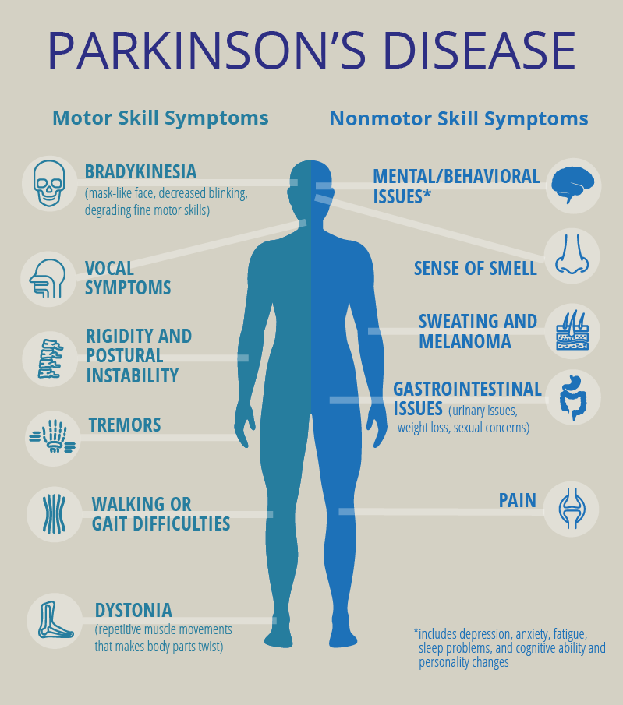
1. Introduction
Parkinson's disease affects movements, cognition, sleep, and other normal functions, with no current cure and worsening over time.
By 2037, an estimated 1.6 million people in the US will have Parkinson's disease, with an economic cost approaching $80 billion.
Research indicates that protein or peptide abnormalities play a significant role in the onset and worsening of Parkinson's disease.
Data science could provide important clues for the development of new pharmacotherapies to slow the progression or cure the disease.
Current efforts have resulted in complex clinical and neurobiological data on over 10,000 subjects for broad sharing with the research community.

Slide 4
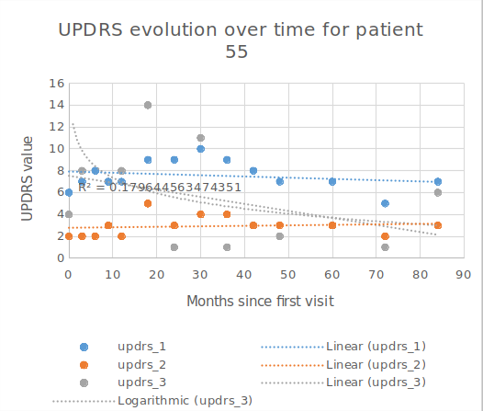
2. Data Exploration

Slide 5
3. Modeling – Random Forest

Slide 6
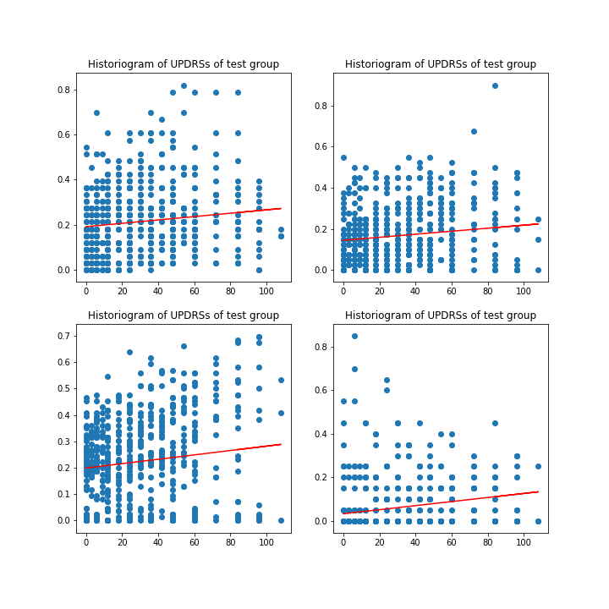
3. Modeling – Linear Regression

Slide 7
4. Results

Slide 8
5. Conclusions

Slide 9

Questions?
Esta foto de Autor desconocido está bajo licencia CC BY-SA

